Slide 1
Regional Environment & Economic Development
Facility Planning Areas 101

Slide 2
Overview
Basics of Facility Planning Areas (FPA)
Big Picture Questions
FPA Planning/Update Process
County-by-County Updates

Slide 3
FPA Basics

Slide 4
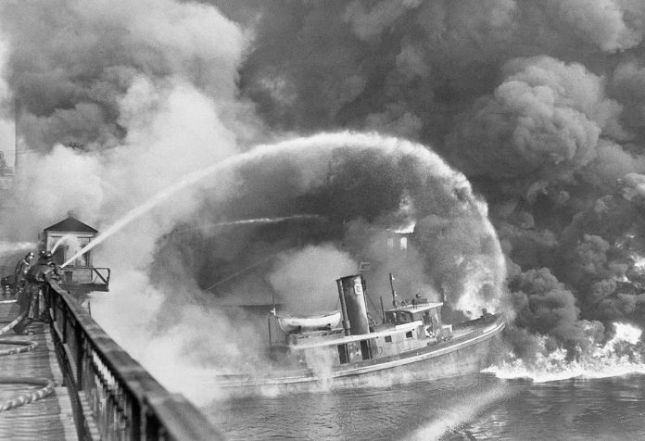
60 Seconds of History
Clean Water Act of 1972
Seeking to address point source pollution in US waters
Construction Grants program
Sec. 201 facility plan
Service/Planning Area, Management Authority, Collection & Treatment, O&M, Financial Plan
Sec. 208 regional plan
Regional coordination to prevent duplication of services, fill gaps
Notes:
So, after the Cuyahoga river caught fire for the 12th time in 1969, there was enough momentum in the environmental movement to win passage of the Clean Water Act in 1972. Among other things, the Clean Water Act required that anyone wishing to discharge pollutants into a waterway had to get a discharge permit. It also created and funded a construction grants program for wastewater treatment facilities. But in order to get a construction grant, a community needed a Facility Plan (as required by section 201) that described the collection system, service area, treatment system, operation and maintenance, and financing. And that 201 Plan needed to be incorporated into a Regional Plan (as required by section 208) that ensured there was no duplication of services. Essentially making sure federal grants were being used wisely.

Slide 5
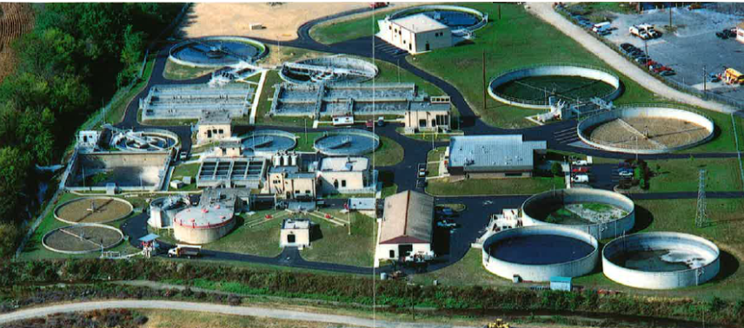
60 Seconds of History
Construction Grants now Revolving Loan Fund
201 and 208 Planning still relevant in Ohio
1996 Blacklick Creek case: Reynoldsburg v. Browner
Ohio EPA-issued permits must be consistent with Regional (Sec. 208) Plans
Notes:
And a lot of planning was done and a lot of treatment systems got funded and built, and the improvement in water quality has been tremendous. The grants program has ended, and now there are revolving loan funds for new plants, and upgrades. But that doesn’t mean we don’t need Facility Planning anymore. Indeed, in Ohio in particular, Ohio EPA cannot issue permits that conflict with the regional plans, so therefore it is critical that 208 plans, and the 201 plans that feed into the 208 plans, are kept up to date.
If your community has a wastewater treatment plant, it should have and regularly update a facility plan for that plant. At the regional level, MVRPC compiles and maintains the Sec 208 Plan – the Areawide Water Quality Management Plan.

Slide 6
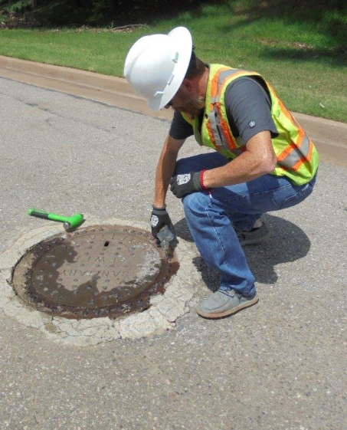
Facility Planning Area (FPA)
The FPA is the area within which the Designated Management Agency is responsible for the planning, financing, construction, maintenance, and operation of wastewater collection and treatment systems.
Notes:
A basic element of a Facility Plan is to define the geographic area for which wastewater services will be provided: The Facility Planning Area. The FPA is the area within which the Designated Management Agency is responsible for the planning, financing, construction, maintenance, and operation of wastewater collection and treatment systems.
The regional plan is in place to make sure none of the FPAs overlap.

Slide 7
Can Be More Than a Line on a Map
Future Service
Not to be served.
Current Service
Notes:
An FPA can be, and many are, simple boundaries on a map. But a detailed facility plan can indicate the area that is currently served, areas that are expected to be served in the next 20 years and even areas that the community expects not to be served in the next twenty years.

Slide 8
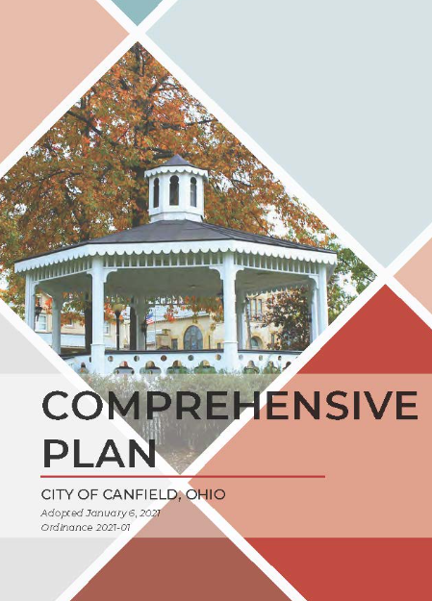
Additional Notes
Based on existing planning
Comprehensive Plan
Land Use Plan
Zoning
Topographical Lines
Gravity sewers
Now, greater comfort with force mains, lift stations, pump stations
Parcel Lines
Notes:
A few other thoughts:
Setting those boundaries should be based on other planning already done in your community – comp plans, land use plans and the zoning based on those plans. The facility plan should be written to meet the larger community goals. A 201 Facility Plan really should not be used instead of a comp plan.
When originally drawn the FPA boundaries often followed lines of slope – what area can be served by gravity sewers. Today with more comfort with pump stations, lift stations and force mains, those considerations are less controlling
In the age of GIS, it is possible to make sure the FPA boundaries line up with parcel lines. Best to make sure a parcel is either in or out of the FPA, and not split in half.

Slide 9
Big Picture Questions
Notes:
So, when your community is taking a look at updating the facility plan and the facility planning area, here are some questions to guide your process.

Slide 10
Updating the Facility Plan and FPA
Where is our community growing?
What does the Comp Plan say?
Will future growth areas need sanitary sewer service?
How much population will we be serving in 20 years?
How much flow is expected?
Notes:
These questions are getting at the potential flow of wastewater through your system. Area times density gives a sense of population, and from that a community can ballpark a flow.

Slide 11
Updating the Facility Plan and FPA
Is our current collection system able to handle that flow? Any bottlenecks?
Is a sewer upgrade needed? Where? By when?
Is our treatment facility able to handle that expected flow and meet Ohio EPA permit requirements?
Is a WWTF upgrade needed? By when?
Has the public had a chance to review and comment?
Notes:
These questions are getting at the capacity of your system to handle the projected flow.

Slide 12
FPA Update Process
Notes:
And once you’re comfortable with all the answers to those questions, and your community has decided that your FPA needs to be updated, you are ready to follow the process for changing how your community is reflected in the regional plan.

Slide 13
Prepare an Update Request
Follow the MVRPC Facility Planning Guidelines
Map
20-year population projection
Existing and proposed waste treatment options
Waste treatment options for any new areas
Current permit limits, current and future WWTF capacity
Notes:
These two slides list out the required elements of a complete request to update your FPA. The guidelines document provides better detail about each.

Slide 14
Prepare an Update Request
“Discussion” elements:
How the proposed update will meet the needs of future population
How proposed update will be protective of the environment and water resources
How the proposed changes agree or conflict with other adopted plans
Documentation of public participation
Notes:
These are the more narrative elements of your submission, in which you can explain the need of the change. Item “i” is often where communities have difficulty.

Slide 15
Process Steps
Proposal submittal
Completeness review
Water & Environment Subcommittee review
Meets five times per year
MVRPC 30-day comment period
Technical Advisory Committee review and recommendation
Meets about 10 times per year
MVRPC Board of Directors review and adoption
Meets about 10 times per year
Notes:
And then your proposed FPA update will pass through these steps for review, comment, and ultimately for adoption by the MVRPC board.

Slide 16
County-by-County Updates

Slide 17
Proactive Approach
Review current FPA and 201 Plan
Go through the “Big Questions”
Ask if there is a need for an update
Plan next steps
Create a package of updates for review instead of a series of one-offs
Notes:
MVRPC wants to avoid situations where a particular development triggers the need for a sudden update to an FPA. And we certainly want to prevent having to do a series of small updates, when a more thoughtful single update could anticipate future development. So, over the next couple of years, MVRPC will be reaching out to communities with treatment systems and requesting to meet and review your community’s current FPA and Facility plan. We’ll have a general discussion of the “Big Questions” and ask if an update to the FPA or the Facility Plan is needed.
In all likelihood we will start in the rural counties where these updates are not as complicated because the FPAs are more spread out. Rebecca Carr and I will be developing a process and then getting started in early 2025.

Slide 18
Questions/Comments
Mr. Matt Lindsay
Manager, Environmental Planning
MVRPC
mlindsay@mvrpc.org
937.531.6548
Ms. Rebecca Carr
Active Transportation and Environmental Planner
MVRPC
rcarr@mvrpc.org
937.531.6547

