Slide 1
Trails Impact Study Matt Lindsay

Slide 2
Miami Valley Trail User Surveys

Slide 3
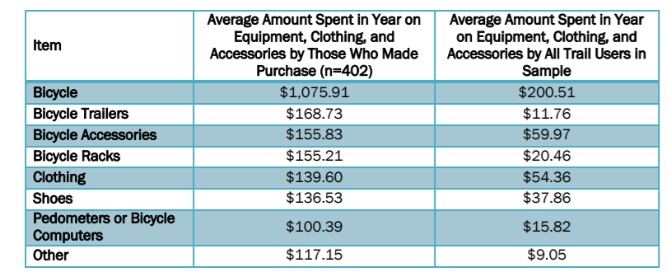
Comparable Studies
Central Ohio Greenways (2015)
User survey and online survey
Regional leader interviews
Hedonic price analysis (real estate)

Slide 4
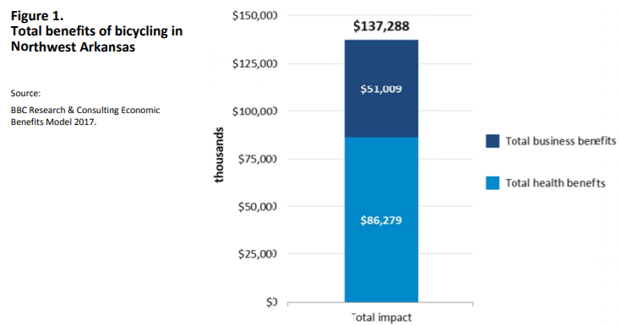
Comparable Studies
Northwest Arkansas (2018)
General Public Survey, Economic, Health, and Real Estate impacts

Slide 5
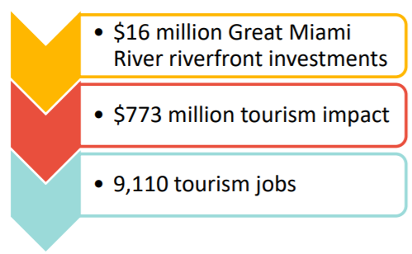
Comparable Studies
Great Miami Riverway (2018)
Tourism-related economic activity along the Great Miami River corridor.

Slide 6
Two Proposals in Hand
 | Tourism Economics | BBC Research
Jobs – Economic Activity |  | Partial
Tourism | Yes
Health Benefits | Partial | Yes
Real Estate | Yes | Yes
Public Survey |  | Yes
Cost | $57,000 | $101,000

Slide 7
Steering Committee – January 25 in Xenia
Participants:
Clark County TCC
Dayton REALTORS
Yellow Springs
Beavercreek
Xenia
Kettering
Dayton
Springboro
Five Rivers
National Park Service
MVRPC
Questions to Pursue:
What do we want from a study?
Can we afford that kind of study?
How do we finance the study we want?

Slide 8
Questions & Comments
Matt Lindsay Manager, Environmental Planning mlindsay@mvrpc.org
937.531.6548

