Slide 1
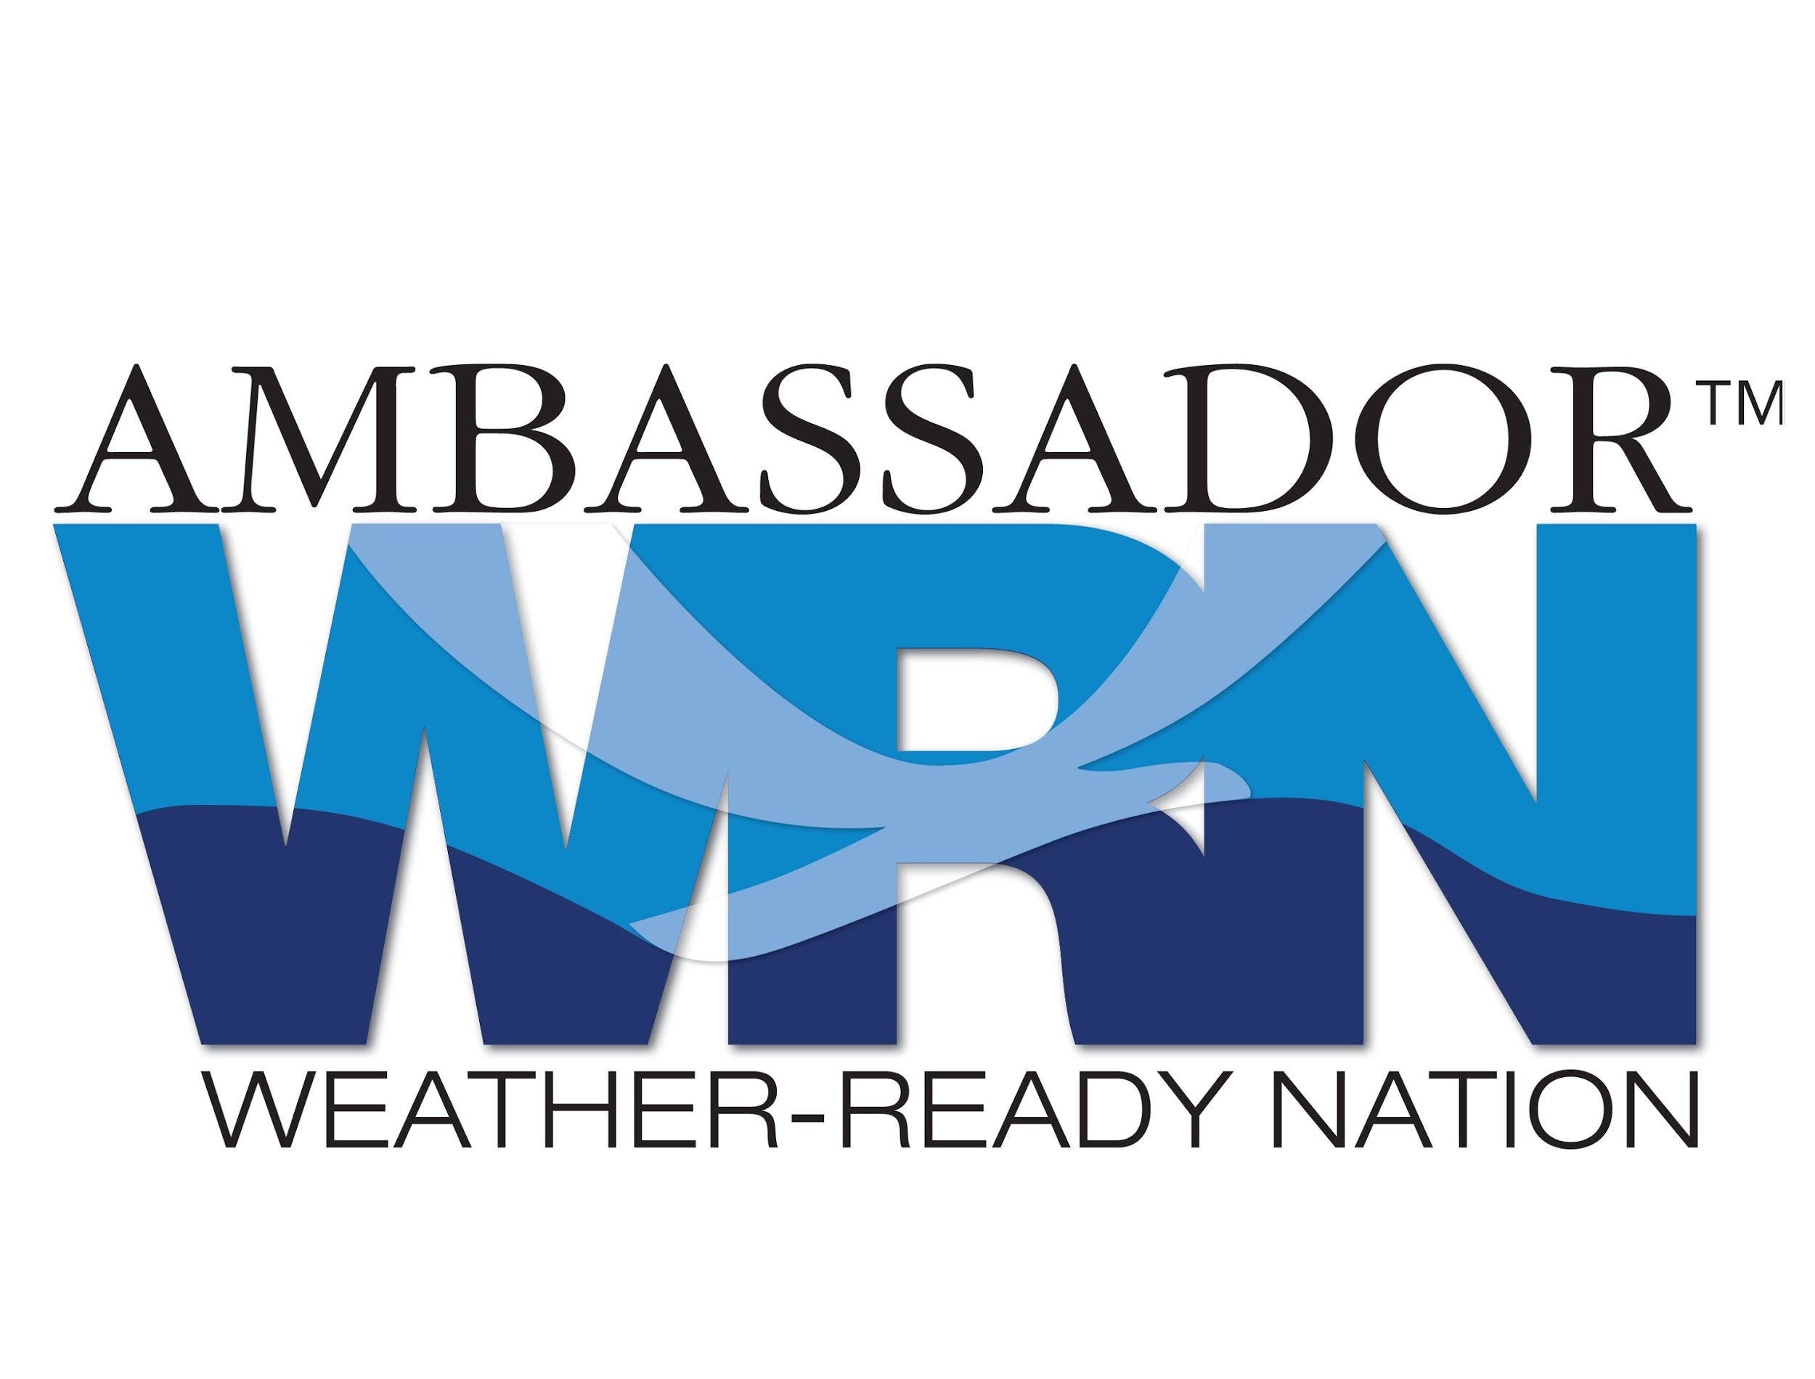
Weather-Ready Nation Ambassadors Thank You MVRPC
Becoming a Weather-Ready Nation is about building community resilience in the face of increasing vulnerability to extreme weather, water, and climate events.
Decreasing Vulnerability by Increasing Resilience

Slide 2
WRN Ambassador Initiative
Goal
Goal: Collectively engage with external organizations that are committed to creating societal response that is equal to weather, water, and climate risks.
Data Providers (i.e., Weather Enterprise)
Maximize value of weather, water, and climate information to society
Mutually benefit NOAA and other government agencies, academia, non-profits, and private sector
Data Users (Decision-Makers)
Meet “life and property” mission more effectively
Strengthen business competitiveness
Data Communicators (Media)
Build consistency in message
Increase outreach
Visit: www.noaa.gov/wrn
Notes:
WRN Ambassadors come in all different shapes and sizes but can be grouped into 3 types.

Slide 3
WRN Ambassador Initiative
How can WRN Ambassadors contribute?
Help make preparedness/resilience a priority
Connect to your social media followers
Engage your own employees
Organize or participate in community events
Do what you do best…every Ambassador organization can provide a unique contribution

Slide 4
WRN Ambassador Initiative
Resiliency
“We can’t stop extreme events from happening. But we surely can come together and find ways to make our societies more dynamically resilient in the face of those threats.”
NOAA Administrator
Dr. Kathryn Sullivan
American Meteorological Society Annual Meeting January 10, 2013

Slide 5
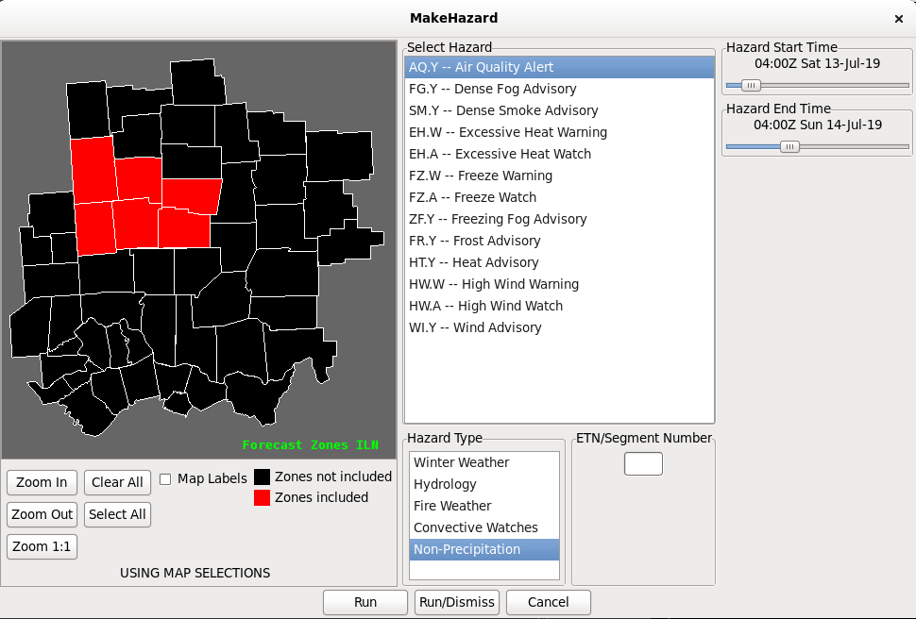
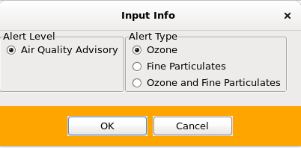
Air Quality Alert
Partners in Messaging
NWS Wilmington notified the day before via NWSChat, email, and/or telephone
Forecasters generate the messaging product and send out based on information received.
Air quality advisory then visible on the NWS webpage.
NWS retweets message from MVRPC on air quality for additional visibility.

Slide 6
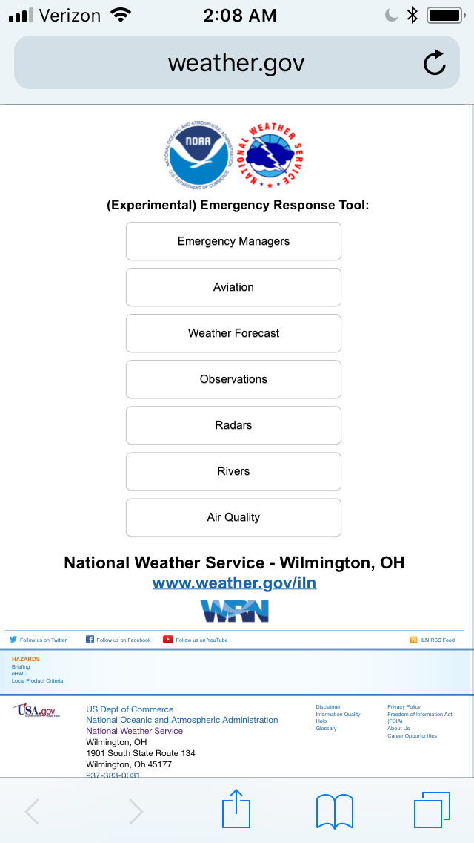
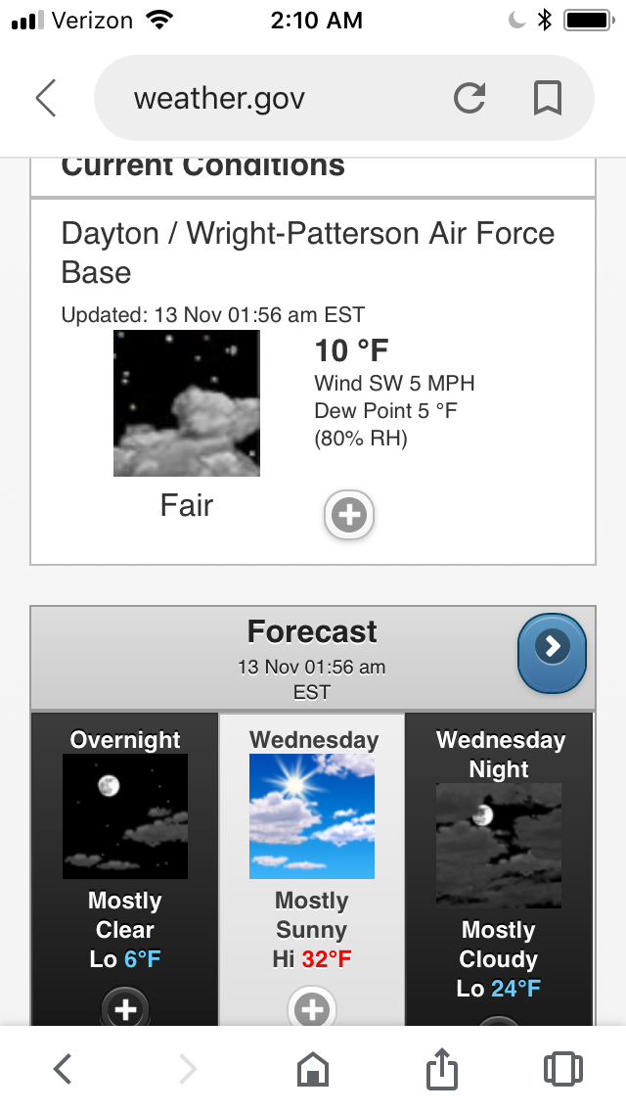
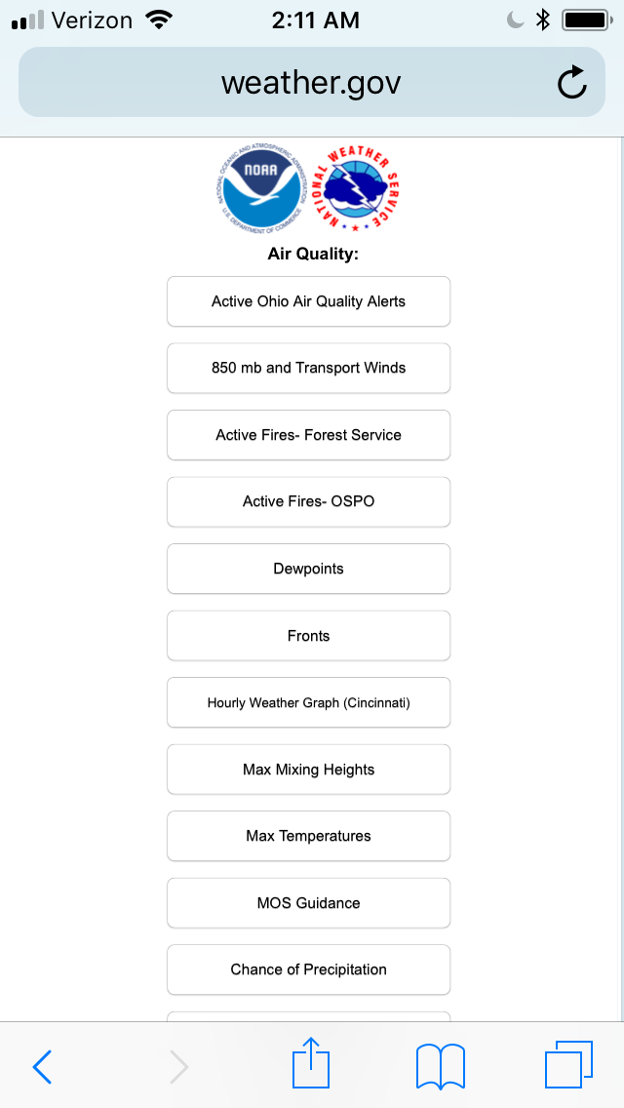
Staying Weather Aware
Multiple Ways To Get Forecast Information
https://www.weather.gov/iln/er_met_widget
https://www.weather.gov/iln/
Or
https://mobile.weather.gov/

Slide 7
Severe Weather
Weather Ready

Slide 8
Severe Weather
Before the Storm
Scenario: Before you go to work, you hear there is a chance for severe thunderstorms in the afternoon. What can you do?
1
Visit our website (weather.gov/iln) to review the hazardous weather outlook
If you have a severe weather safety kit and/or NOAA All-Hazards Radio, you should make sure that everything has fresh batteries that work. You should check your radio, flashlight, etc. because they may become necessary later in the day. Make sure your cell phone is fully charged in case you lose power.
2
If you have a severe weather safety plan, you should review it. Make sure everyone in your family knows what to do in certain situations. Know where everyone will be during the day and make it clear what to do if severe weather impacts your location. Know where to seek shelter beforehand!
3
Whether it be via local television, our webpage, an app on your mobile device, AM/FM radio, the Internet, NOAA All-Hazards Radio, etc., continue to monitor weather information during the day for any changes in the situation. Set up a routine (i.e. check the weather information every hour on the hour).
4

Slide 9
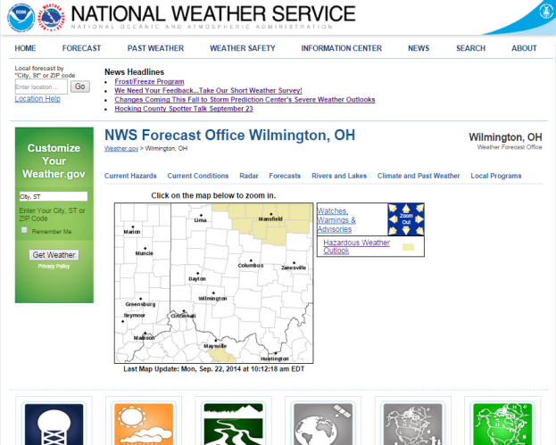
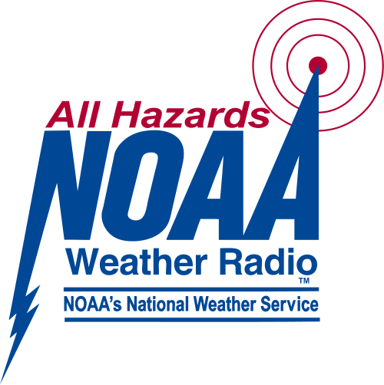
Severe Weather
When a Watch is Issued
Scenario: While at work, you hear a tornado watch has been issued.
Check the radio, local media, or our website for clarifying details on the watch. Know that watches may be issued hours before a storm may arrive in your area.
If your NOAA All-Hazards Radio was not already turned on, definitely make sure it’s on and the batteries are working. The radio will alert you if a warning is issued, so it is vital to have it on and working correctly.
If you don’t own a NOAA Weather Radio, you should check our website or tune in to the media (either television or radio) to stay updated on the situation.
Know where to go and what actions to take should a severe thunderstorm or tornado warning be issued for your area.

Slide 10
Severe Weather
Always Have Three Ways to Receive Warnings
NOAA Weather Radio
NOAA Weather Radio
NOAA Weather Radio
Wireless Emergency Alerts (WEA) come as a default setting on most wireless carriers (only certain warnings)
NOAA Weather Radio
Cell Phone / Mobile Device
Television

Slide 11
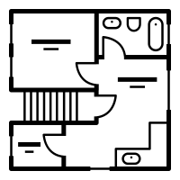
Severe Weather
Have a Plan
Always have at least 3 ways to receive crucial warning information.
Have a disaster supply kit in your office where everyone knows its location!
Have a clearly-defined and well-known safe place in your office. Have this displayed in your office.
Office Tornado Shelter
Notify your coworkers of the weather situation as quickly as possible! Practice tornado drills on a routine basis.
If on the road on a routine basis, know your location in relation to the nearest sturdy structure!

Slide 12
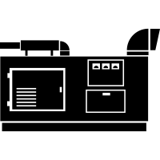
Winter Weather
Have a Plan
Have a disaster supply kit in your office where everyone knows its location!
If on the road, have non-perishable food and blankets and coats in the vehicle with you at all times in case your vehicle becomes stranded!
Always have means to communicate with your friends, coworkers, and family if a winter storm is on its way.
In case of loss of electricity, never use a backup generator in an enclosed space!
X

Slide 13
Severe Weather
When a Warning is Issued
Scenario: While at work, you receive notification on your cell phone that a tornado warning has been issued for your area.
Move indoors and away from windows. Even straight-line winds or large hail from a severe thunderstorm can cause damage. Be aware of the situation around you.
Put your severe weather safety plan into action. Notify other coworkers of the threat so that everyone can take the necessary actions to stay safe until the storm has passed.
Tornado warnings contain info that list cities in the path of the storm. While the NWS strives to provide detailed info, every city may not be directly listed in a warning. Because of radar limitations, time and locations listed in warnings are subject to minor errors. Allow yourself plenty of time to get to your safe place.
THE NATIONAL WEATHER SERVICE IN WILMINGTON HAS ISSUED A
* TORNADO WARNING FOR... SOUTHWESTERN MONTGOMERY COUNTY IN WEST CENTRAL OHIO... NORTHEASTERN BUTLER COUNTY IN SOUTHWESTERN OHIO...
Stay in your tornado shelter or interior room until the storm has passed or the tornado warning has been cancelled or expired.
* LOCATIONS IMPACTED INCLUDE... MIDDLETOWN...GERMANTOWN AND POAST TOWN HEIGHTS.

Slide 14
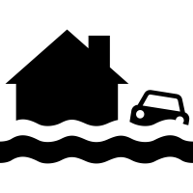
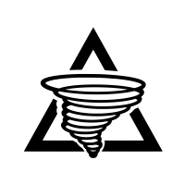
Severe Weather
Storm Reports
If you observe damage, flooding, or a tornado, and are in a safe place, please give us a call or report on social media!
What we want to know…
NWS
Real-time verification of damage occurring adds credibility, enhances public response, and improves warning accuracy!
Your storm reports may help keep others safe!
A tornado has been reported 3 miles N of…

Slide 15
Severe Weather
Memorial Day Tornadoes

Slide 16
Ensuring a Weather Ready Nation
The Importance of Partnerships
The National Weather Service (NWS) is an organization that relies heavily on science, partnerships, and ties to local communities to successfully provide weather, water, and climate data, forecasts and warnings for the protection of life and property and the enhancement of the national economy.
The NWS works with many partners, including those from national and local government, members of the weather enterprise, Weather-Ready Nation Ambassadors, and Academia to help educate people in all communities on how to stay safe and ensure important weather information, such as warnings, reach the broadest possible audience.

