Slide 1

Greater Region Mobility Alliance
December 2024

Slide 2
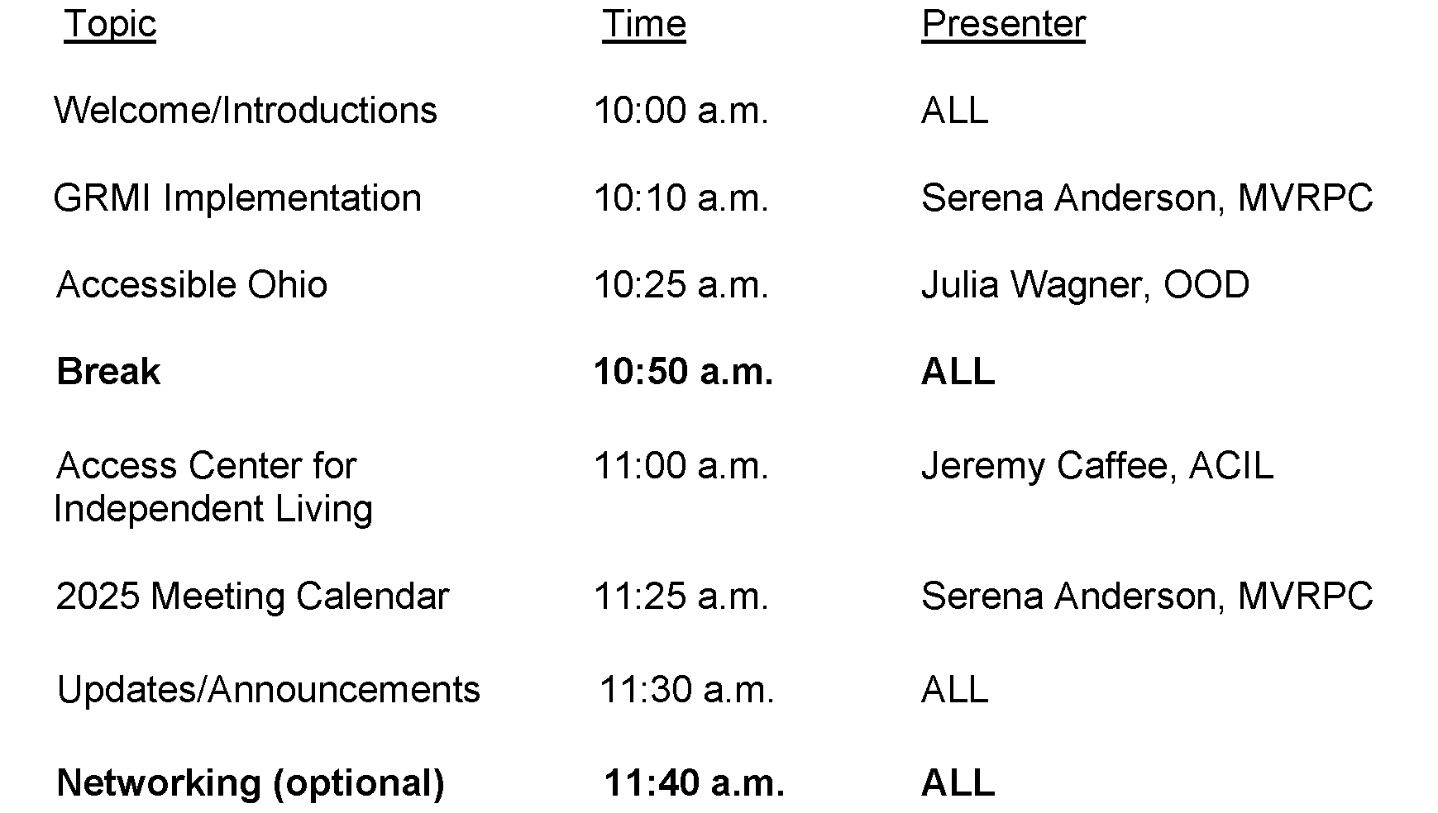

Slide 3


Slide 4
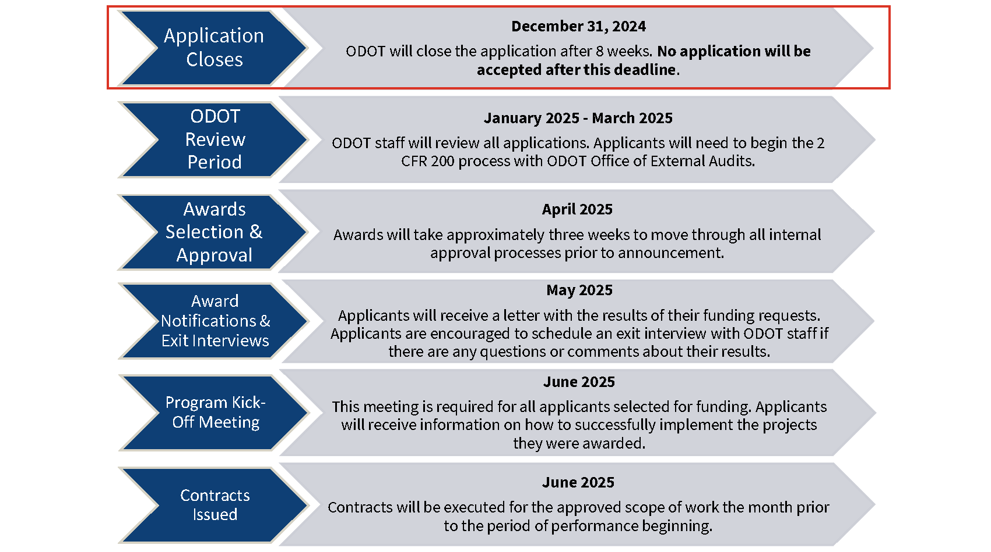

Slide 5

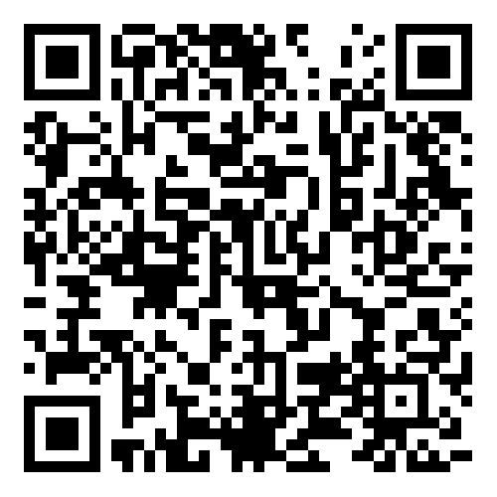
Open Office Hours

Slide 6


Slide 7
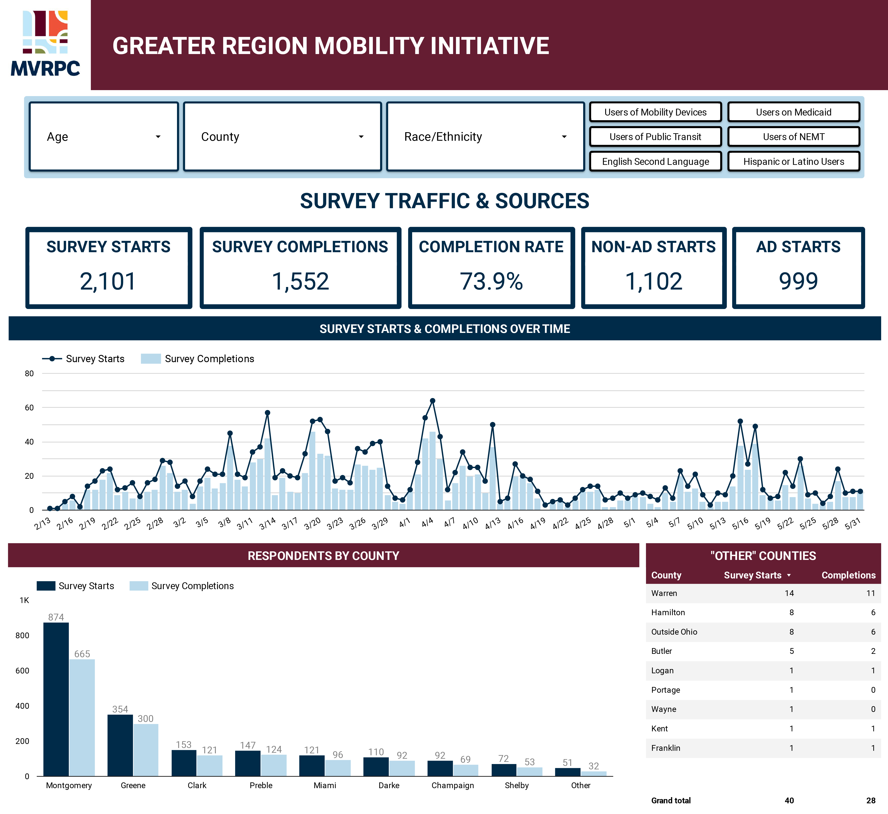
www.mvrpc.org/mobility/survey

Slide 8
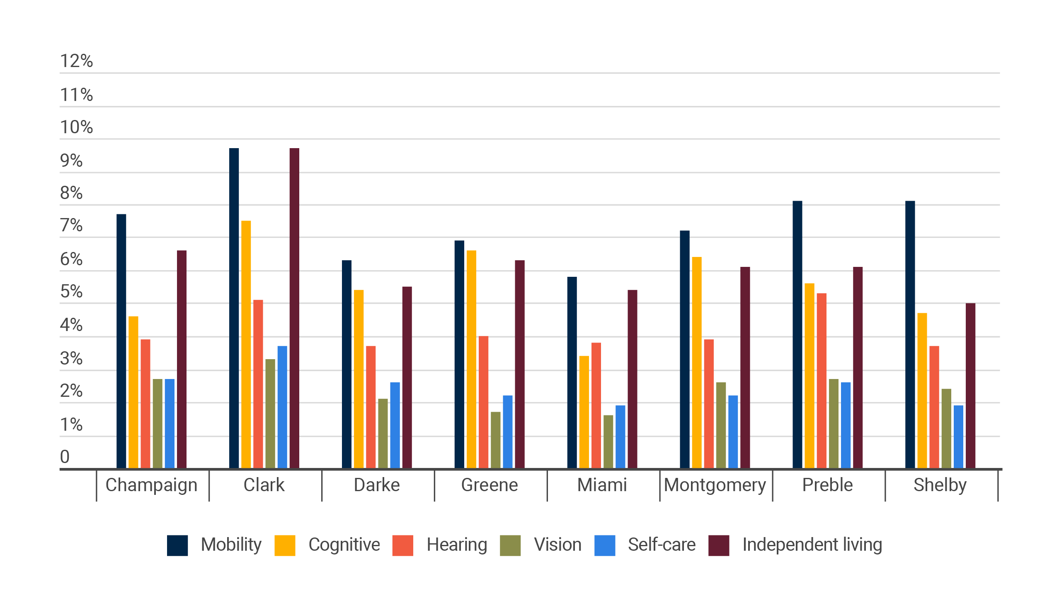
www.mvrpc.org/mobility/demographics

Slide 9
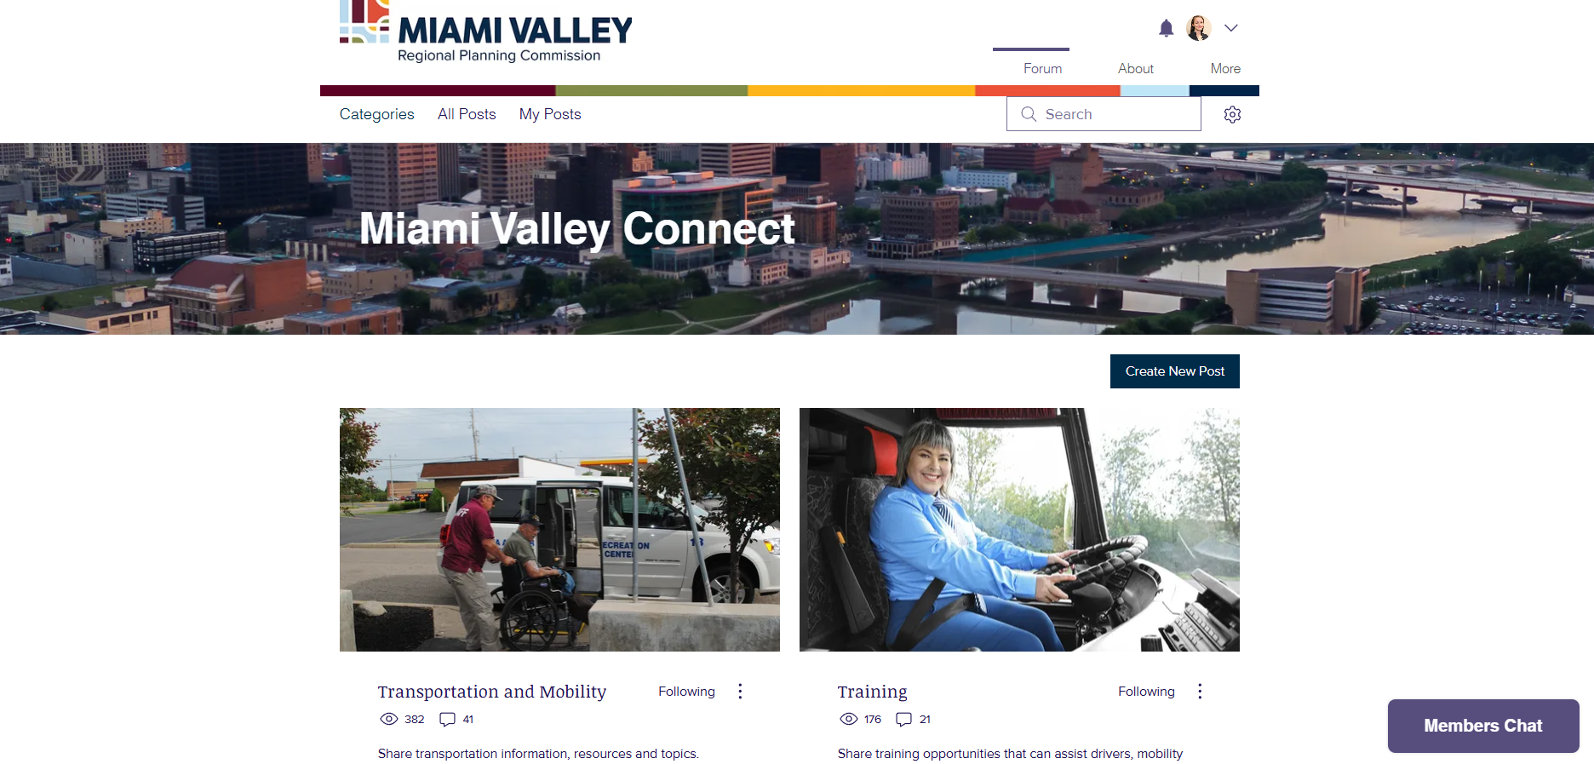
https://www.discussion.mvrpc.org/

Slide 10
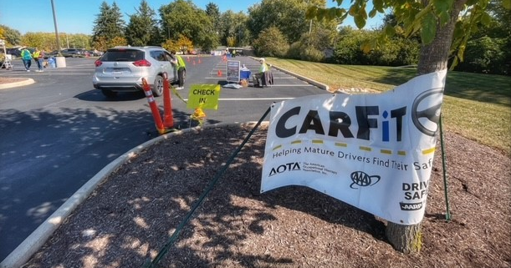

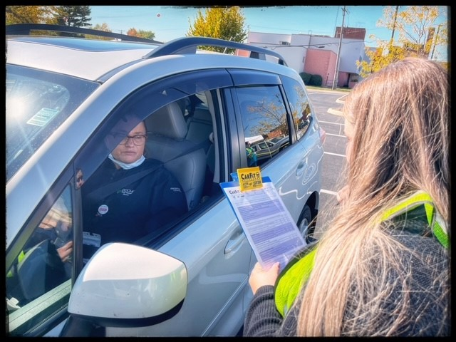

Slide 11


Slide 12
Education & Advocacy
Community fact sheets
Resources
Driver training
Assessments
Transfer points
Preventative maintenance
Scheduling software
Trip denials
Revamp Miami Valley Ride Finder
Cost metrics

Slide 13
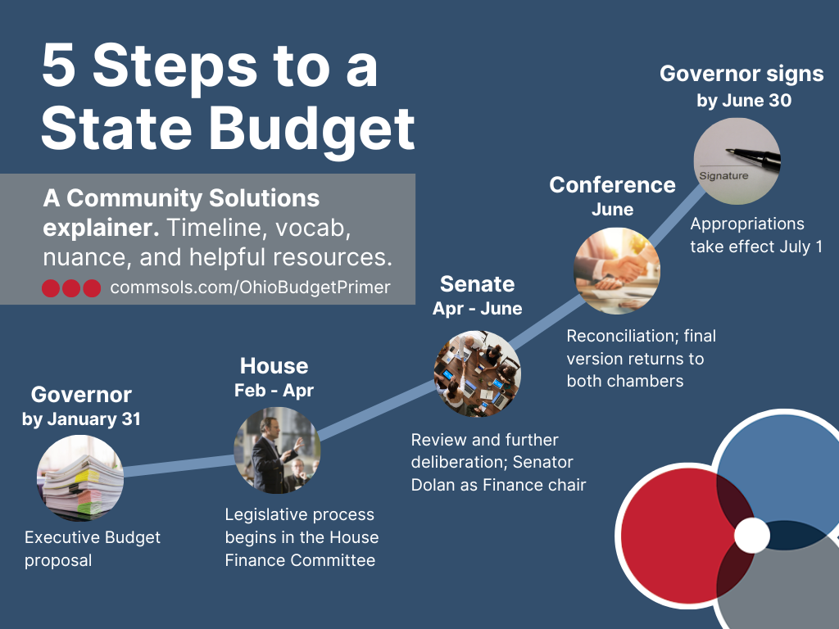

Slide 14
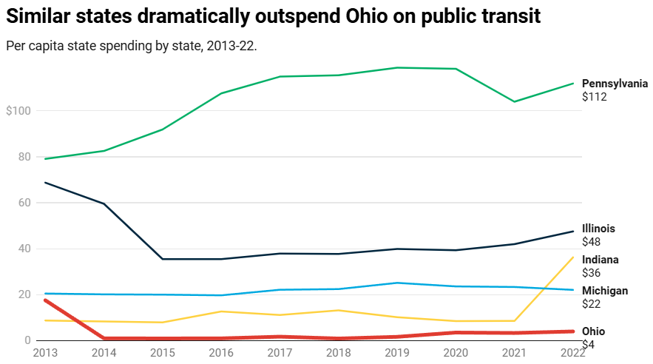
https://www.policymattersohio.org/files/research/transitfundingfinal.pdf
Notes:
Fund 10% of statewide public transit spending through state budget appropriations by 2025 — a goal set by ODOT in 2015. Reduce regional transit authorities’ reliance on local funding sources by putting forward additional state funding for public transit. We have a long way to go to meet this goal: In 2022, state investments represented only 4% of Ohio transit agencies’ funding receipts. A major shift in Ohio’s transportation funding priorities is necessary to improve transit services.

Slide 15
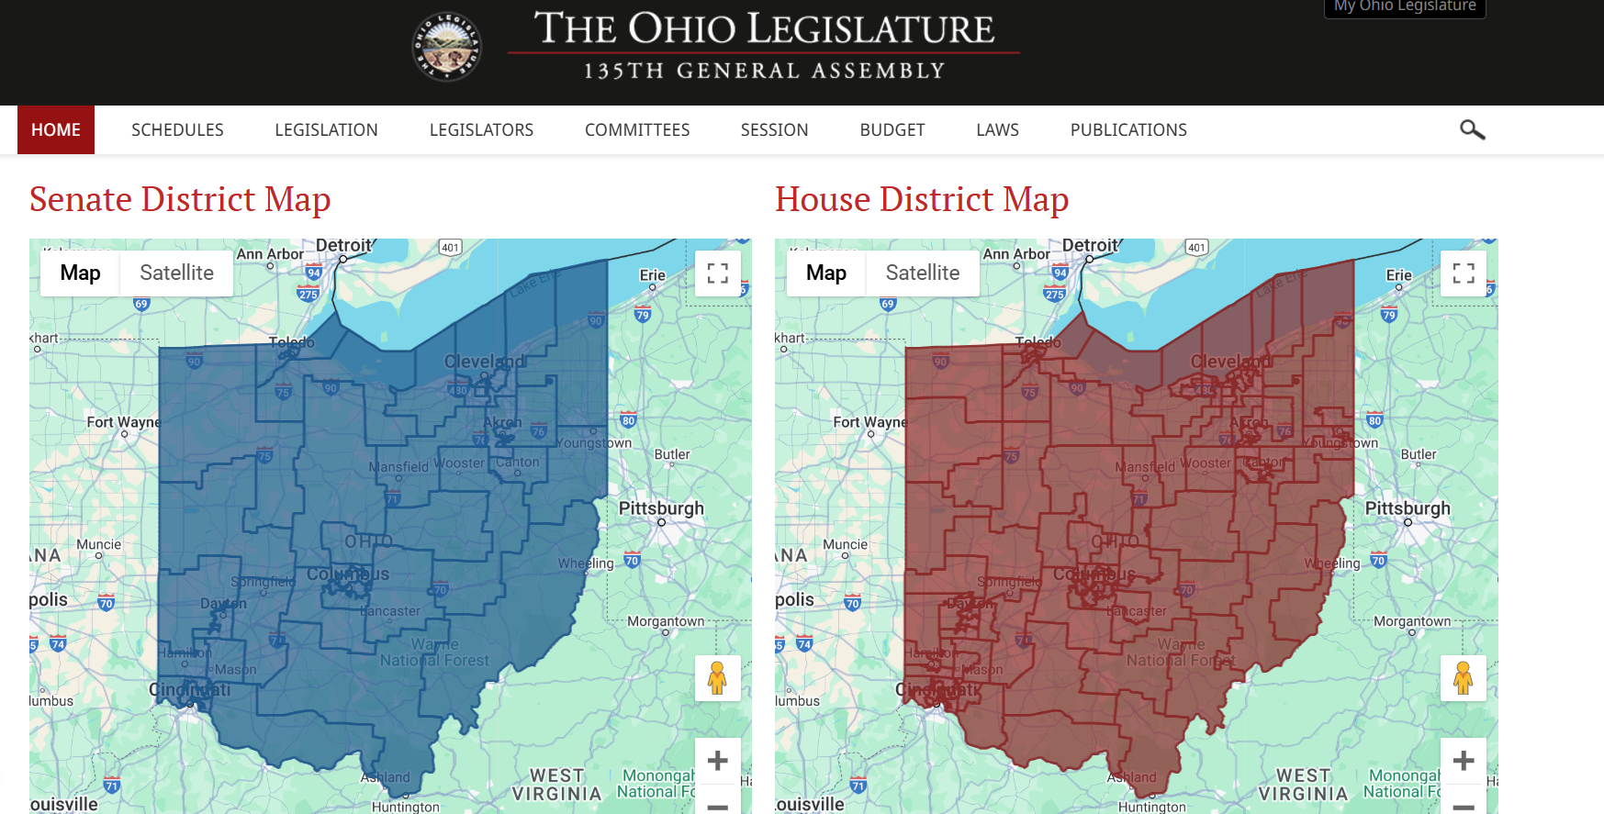
https://www.legislature.ohio.gov/members/district-maps

Slide 16


Welcome
Julia Wagner, OTD, OTR/L, ADAC
December 10, 2024

Slide 17

Opportunities for Ohioans with Disabilities
Division of Disability Determination (DDD)
Employer and Innovation Services (EIS)
Bureau of Services for the Visually Impaired (BSVI)
Bureau of Vocational Rehabilitation (BVR)

Slide 18

Accessible Ohio
Overview
Prioritize accessibility
Promote inclusion
Ensure equitable access
Accessible Ohio Specialists
OOD.Ohio.Gov/Accessible-Ohio
AccessibleOhio@ood.ohio.gov

Slide 19
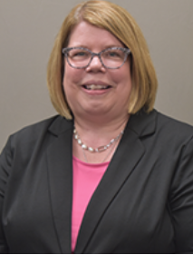
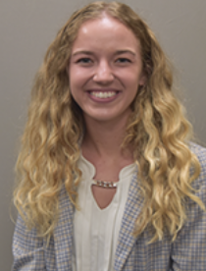
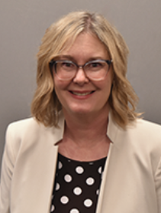
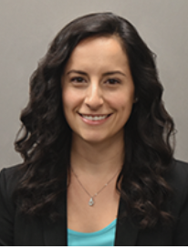

Accessible Ohio Specialists
Shelly Burkhart, ADAC
Northwest
Brianna Potter, OTR/L, ADAC
Northeast
Tanya K. Vela,
OTR/L, ADAC
Southeast
Julia Wagner, OTD, OTR/L, ADAC
Southwest
OOD.Ohio.Gov/Accessible-Ohio
AccessibleOhio@ood.ohio.gov

Slide 20





Information and Resources
Accessible Ohio Services
Consultations
Training and Education
Online Tools and Guides
Conference and Expo
OOD.Ohio.Gov/Accessible-Ohio
AccessibleOhio@ood.ohio.gov

Slide 21




Accessibility Priorities
Planning & Awareness
Navigation
Personal Care
Experience
OOD.Ohio.Gov/Accessible-Ohio
AccessibleOhio@ood.ohio.gov

Slide 22
Conclusion
OOD.Ohio.Gov/Accessible-Ohio
Julia.Wagner@ood.ohio.gov

Slide 23
Break

Slide 24

Access Center for Independent Living
165 E. Helena Street
Dayton, Ohio 45404

Slide 25

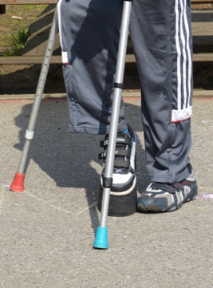
Access Center’s Mission & Vision
Mission is to ensure that individuals with disabilities have full and complete access to the community in which they choose to reside.
Our Vision: An Accessible Community Where Everyone Is Included

Slide 26
ACIL
Founded in 1984
Provides services to individuals with disabilities and their support systems
Service Area include Champaign, Clark, Darke, Greene, Logan, Miami, Montgomery, Preble, and Shelby Counties
Independent Living Program
Recycled Equipment Donated for Independent (REDI)
“Think This Is Easy?” Disability Awareness Training
Peer Mentorship Project
HOME Choice program through partnership with National Church Residence
Living Well In the Community
Services provided by ACIL are free of charge to individuals with disabilities

Slide 27
ACIL Continued
Funders
ACIL Stats and Facts
Health & Human Services Administration on Community Living
State of Ohio
Fee for Service programs
Grants
Donations
Over 51% of the Staff and Board of Directors are individuals with disabilities
Served 142 Consumers in the IL Program
Spent 1,349 hours conducting community outreach, training, and technical assistance

Slide 28
Centers for Independent Living (CILS)
12 CILS in Ohio
Over 450 in the United States
Non-residential Center for Independent Living
CILS created through the Rehabilitation Act of 1973 Sec 7-part C

Slide 29
Independent Living Program
Five Core Services
    Services are self-directed and goals are developed by the consumer with the IL Specialist as a guide
  Information & Referral
    Available to anyone who calls or comes to the center
  Independent Living Skills Training
    Money Management
    Daily Living Skills
    Employment
  Systemic & Self Advocacy
    Consumers learn skills to advocate for themselves
    IL Specialist can advocate on consumers behalf

Slide 30
Independent Living Skills Continued
  Transition
    Transition from facility-based living to Independent Living in the Community
    Youth transition from Post-Secondary Life to Independent Life
      Assistance with learning employability skills, resumes, job searching, furthering education, and transition to independent living
  Peer Support
    Breaking Silences
    Traumatic Brain Injury Support Group (TBI)
      Coming in early 2025

Slide 31
Information and Referral
Provide information about disability-related issues, resources, and services to
  Individuals with disabilities
  Families and Caregivers
  Professionals
  General public
Our staff, the majority of whom are people with disabilities themselves, are available to listen and assist with locating resources and developing strategies for individuals to resolve barriers including, but not limited to, the following areas:
Home and Community Based Services, Health Care, Housing, Transportation, Employment, Benefits and Funding, Accessibility, Discrimination and Legal Rights, Adaptive Equipment, and Community Supports and Services.

Slide 32
Independent Living Specialist
Independent Living Specialists- Staff at the Access Center that specialize in living independently in the community
  They will meet with individuals and assist them in determining their need for services such as housing, applying for benefits, advocating, independent living skills and/or education.
  If the individual determines they want to become a Consumer at the Access Center, they complete an Independent Living Plan with their staff member.
  The Independent Living Plan is a document outlining their goals and how the goals will be achieved. Once the Independent Living Plan is completed then there is ongoing communication with the Consumer to check on the progress of their Goals until they are completed, and new goals can be added at any time.

Slide 33
Community Transition through HOME Choice
ACIL works with National Church Residences to provide HOME Choice transition services to individuals with disabilities who wish to transition from facility-base or institutional settings to community independent living
Consumers work with ACIL’s transition Coordinator to develop a plan for transition, search for appropriate housing, and household set up.
Consumers approved for HOME Choice have 180 days to transition and receive a one-time stipend up to $2,000 to assist with securing housing, utility service, and/ household goods

Slide 34

“Think This Is Easy?” (TTIE)
  Participants rotate through 8 disability stations
  Each station is facilitated by an individual with a disability
  At each station participants experience a different disability to the extent possible
  Stations include
    Cognitive
    Dexterity
    Speech
    Hearing
    Vision I & II
    Autism Spectrum
    Mobility Obstacle Course

Slide 35
Youth Leadership Forum (YLF)
Youth Leadership Forum
  A weeklong summer career leadership training program preparing young individuals with disabilities to identify existing barriers to personal and professional success and develop plans to overcome them. They interact with professional individuals with disabilities who serve as mentors. They also develop leadership plans for their goals in education, careers, and community leadership after the conference.

Slide 36
Recycled Equipment Donated for Independence (REDI)
  REDI provides individuals with disabilities durable medical equipment that will assist in continued independence and reduce the risk institutionalization.
  REDI Provides equipment free of charge (Monetary Donations Accepted)
  Equipment we have available
    Hospital Beds, Walkers, Wheelchairs, Bath chairs, Incontinence supplies, Canes, Scooters, Lift Chairs, Other adaptive and durable medical equipment. Alcohol wipes, All equipment is subject to availability
  Items we cannot take include medications, clothing, household items, CPAP/Oxygen machines & tanks, syringes, Glucose monitoring equipment, Nutritional supplements (Ensure), broken, or excessively soiled equipment

Slide 37
Public Health
Public Health Departments- Emergency Preparedness Committees and as a resource
WCO Healthcare Coalition- participant
Covid-19 Unmet Needs Survey- completed in 2020-2021 about the unmet needs of Ohioans with disabilities during the Covid-19 pandemic.
  The survey results can be found on our website under Covid-19 services if anyone is interested in reading the full report.
  We are repeating the survey post-pandemic to determine the areas that were missed in the initial survey as well as addressing some of the survey limitations. I am working with Wright State, and we are looking to start the process in the next month or two.
Independent Living Emergency Preparedness Goals- an area that we talked about with some EMA and Emergency Response Coordinators about the best ways we can help identify our consumers living independently in the community
  Determining if we have the potential to offer an emergency preparedness course for our consumers to be prepared for emergencies that impact our area.

Slide 38
Contact Information
ACIL
165 E. Helena St. Dayton, Ohio 45404
937-341-5202
www.acils.com
info@acils.com
Jeremy.caffee@acils.com

Slide 39
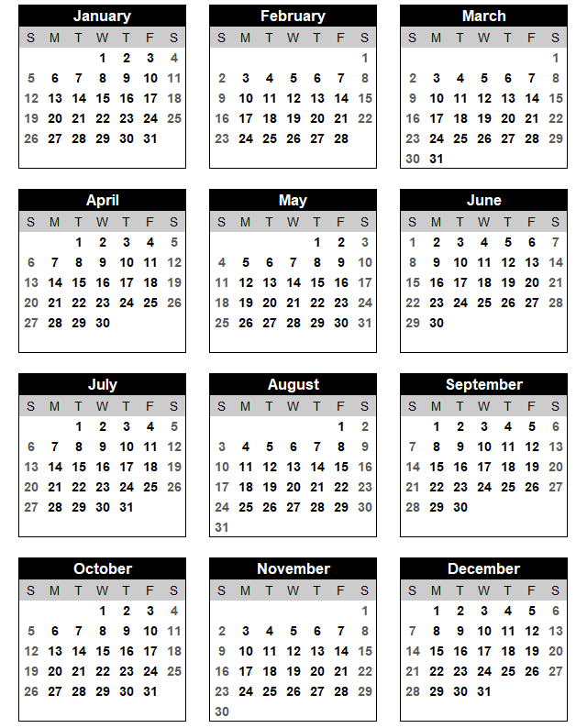
2025 Meeting Calendar
MC Business Solutions Center (Dayton) or Goodwill Easterseals Miami Valley West Campus (Trotwood)
March 18, 2025
September 16, 2025
Edison State College (Piqua)
June 17, 2025
December 16, 2025

Slide 40


